Slide 1
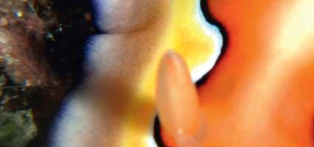
Chapter 1: Biodiversity

Slide 2
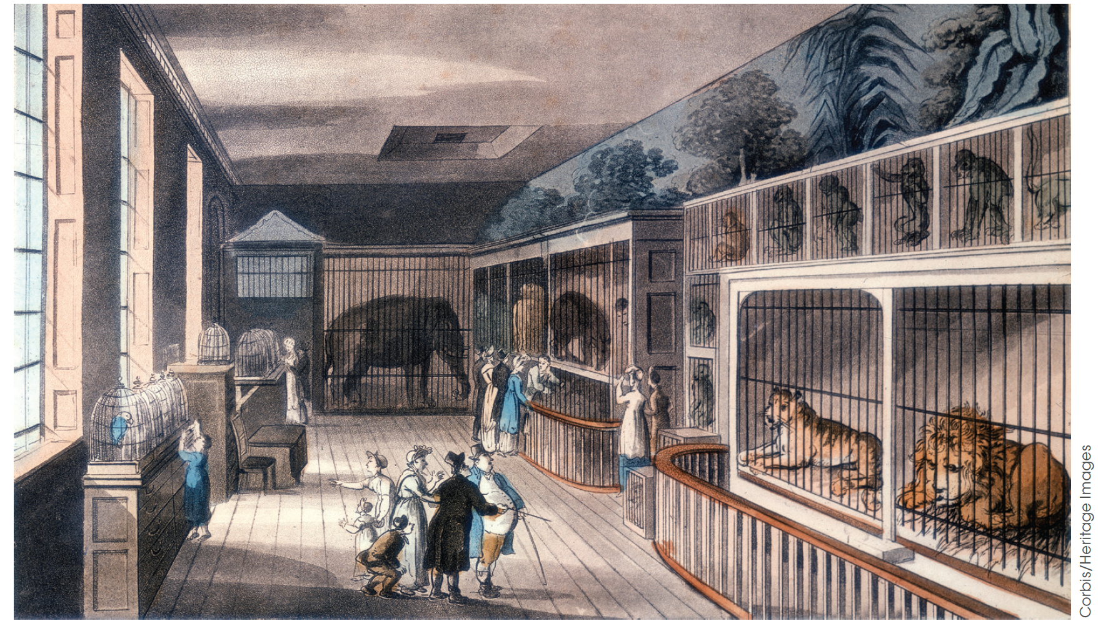
The diversity of life
Figure 1.1
The Royal Menagerie (an early form of the zoo), Tower of London, 1816.
Notes:
We live in a world with amazing forms of life. In many places, there are still more unknown species to be uncovered. Back in the 18th and 19th centuries, explorers sailed the world on voyages of discovery. Naturalists and collectors took advantage of these voyages and they wrote detailed accounts of what they observed. These accounts were widely read back home in Europe by a public fascinated by exotic places and things. The general public in Europe was sceptical of the far off lands and they marvelled at the specimens brought back from expeditions. Wealthy patrons sponsored collectors to bring back live exotic animals and plants, and private menageries and public zoos were created. At the same time, naturalists began to question age-old beliefs about the physical and living world around them. They noticed how unseen lands brought unknown species and they began to wonder why this was so. It was in part due to his own voyage of discovery that Charles Darwin developed his theory of evolution by natural selection.

Slide 3
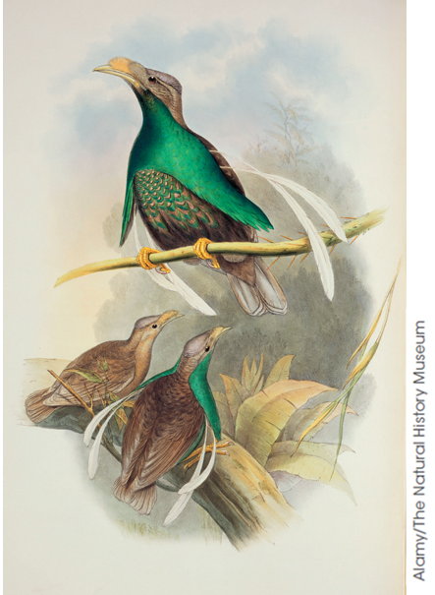
Voyage of discovery
The diversity of life
Alfred Russel Wallace
HMS Endeavour – Joseph Banks
HMS Beagle – Charles Darwin
Figure 1.3
Semioptera wallacii, Wallace’s standardwing,
the new bird of paradise that Wallace discovered on the island of Batchian (now the Bacan Islands in Indonesia).
Notes:
Wallace discovered 5000 new species and collected more than 125 660 specimens.
HMS Endeavour. The naturalist on board the Endeavour was Joseph Banks. He documented the species during the voyage to the Pacific including Australian and New Zealand native species. The plant material he collected from eastern Australia was extensive and accounted for about 110 new genera and 1300 new species.
HMS Beagle. In January 1836 Charles Darwin arrived in Australia. He did not travel far from Sydney but noted the strangeness of Australia’s animals. He observed several animals that were clearly similar in form and behaviour to similar animals in England. These included crows and magpies, as well as the ant lion, a small insect that digs pits in sandy soil into which unsuspecting prey can fall. These species were named after familiar species in Europe, but they actually belong to completely different species.

Slide 4
Wallace discovered 5000 new species and collected more than 125 660 specimens.
HMS Endeavour. The naturalist on board the Endeavour was Joseph Banks. He documented the species during the voyage to the Pacific including Australian and New Zealand native species. The plant material he collected from eastern Australia was extensive and accounted for about 110 new genera and 1300 new species.
HMS Beagle. In January 1836 Charles Darwin arrived in Australia. He did not travel far from Sydney but noted the strangeness of Australia’s animals. He observed several animals that were clearly similar in form and behaviour to similar animals in England. These included crows and magpies, as well as the ant lion, a small insect that digs pits in sandy soil into which unsuspecting prey can fall. These species were named after familiar species in Europe, but they actually belong to completely different species.

Slide 5
What is biodiversity? Biodiversity: the variety of living things. “the variability within species, between species, and between ecosystems.” Scientists have come to recognise biodiversity at a number of different levels. 1. The level of species. A species is most often defined as a group of morphologically similar organisms that is capable of interbreeding to produce fertile offspring. 2. The level of ecosystem. Organisms live in quite complex communities and a range of different physical Environments. Consider the difference between the sorts of communities and physical conditions present in the alpine regions of Australia with those found in the tropics.
Describing biodiversity

Slide 6
3. The level of genetics. Genetic diversity is now widely recognized for its biological importance. Every individual carries a large number of genes, which code for all of their inherited traits, and different individuals carry many different genes. For example, the whole human population carries many different eye or hair colour genes. A whole population will carry many different genes. In general terms, it seems that populations with higher genetic diversity (i.e. the greatest mix of different genes) are more resilient. This makes them more likely to survive sudden changes in the environment than populations with low genetic diversity.

Slide 7
Diversity of species
Describing biodiversity
What is a species?
A species is a group of organisms that share a gene pool; all members of the same species have the capacity to interbreed to produce fertile offspring as long as they are not prevented by any physical barrier.
The biological species concept
The biological species concept is the definition of a species based on the capacity of individuals to interbreed.
Notes:
1. A species is a group of organisms that share a gene pool; all members of the same species have the capacity to interbreed to produce fertile offspring as long as they are not prevented by any physical barrier.
2. The biological species concept is the definition of a species based on the capacity of individuals to interbreed.
3. While the biological species model has relevance to the processes whereby new forms of life evolve, particularly at the genetic level, there are a number of problems in using this definition.
For example, it is not possible to apply it to fossils of extinct organisms, since it is never possible to really know which individuals could interbreed with another. Often, where two identified species have populations that overlap to some extent, there are zones where hybrid organisms exist. Hybrids are difficult to classify since they are the result of individuals from two different species interbreeding. They generally do not survive well outside restricted hybrid zones and generally do not displace either of the parent species, but they do play an important role within the ecosystem. Hybrids present a problem from a conservation perspective since most legislation is designed to identify a particular species for protection, and therefore does not protect the hybrid organisms, despite their role in the overall ecological system.
4. When examining fossils, the morphological species concept is most commonly applied. This concept characterises a species by its form, or morphology. The phylogenetic species concept identifies a species as being the smallest group of organisms who can all trace their origins to a single common ancestor. This is, in fact, an important feature of all classification systems used today.

Slide 8
3. Limitations of the biological species model
It is not possible to apply it to fossils of extinct organisms, since it is never possible to really know which individuals could interbreed with another.
Often, where two identified species have populations that overlap to some extent, there are zones where hybrid organisms exist. Hybrids are difficult to classify since they are the result of individuals from two different species interbreeding. They generally do not survive well outside restricted hybrid zones and generally do not displace either of the parent species, but they do play an important role within the ecosystem.
Asexual organisms do not interbreed and so cannot be classified using this definition.

Slide 9
4 Other species concepts
When examining fossils, the morphological species concept is most commonly applied. This concept characterises a species by its form, or morphology.
The phylogenetic species concept identifies a species as being the smallest group of organisms who can all trace their origins to a single common ancestor. This is, in fact, an important feature of all classification systems used today.

Slide 10
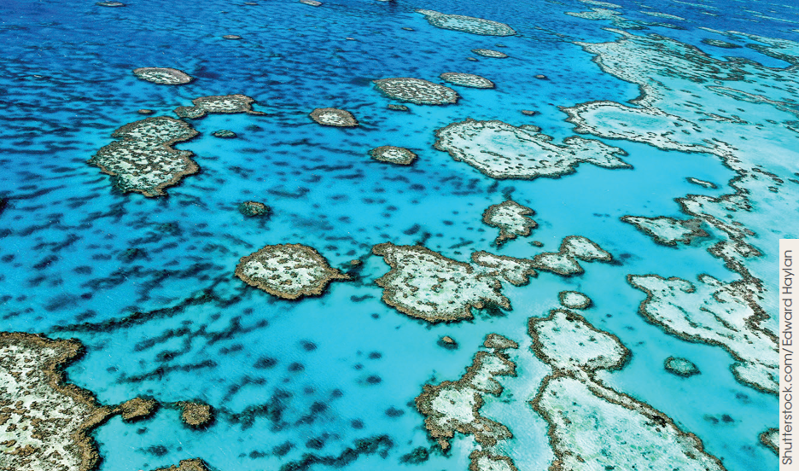
Biodiversity of Australia
Biodiversity in Australia
Landscape and the types of plants and animals, including marsupials.
1 million species of plants, animals and insects
Figure 1.6 The Great Barrier Reef from the air
Notes:
Australian flora and fauna stands apart from that of the rest of the world for several reasons.
Firstly, it is quite different to that found anywhere else on Earth. The vast forests of eucalypts that characterise the Australian landscape are not found outside Australia and South East Asia.
The second important characteristic is diversity. It has been estimated that Australia has about 1 million species of plants, animals and micro-organisms, representing approximately 7% of the world’s total. In fact Australia is one of only two developed nations, along with the USA, to be recognised as a ‘megadiversity’ country; a country possessing particularly diverse living systems. Australia is one of the most sparsely populated ‘megadiversity’ countries in the world. A report
prepared for the Australian Biological Resources Study in 2009 estimated that 566 398 species exist in Australia.

Slide 11
Australian flora and fauna stands apart from that of the rest of the world for several reasons.
Firstly, much of Australia’s wildlife is endemic – found nowhere else on Earth.
The second important characteristic is diversity. It has been estimated that Australia has about 1 million species of plants, animals and micro-organisms, representing approximately 7% of the world’s total. In fact Australia is one of only two developed nations, along with the USA, to be recognised as a ‘megadiversity’ country; a country possessing particularly diverse living systems. Australia is one of the most sparsely populated ‘megadiversity’ countries in the world. A report prepared for the Australian Biological Resources Study in 2009 estimated that 566 398 species exist in Australia.

Slide 12
Development of the ecosystem concept – still a work in progress!
A diversity of ecosystems
When does one ecosystem start and one end?
Life on Earth is connected through the cycling of nutrients and the transformation of energy through food webs.
Ecosystems are generally homogeneous, but some regions within an ecosystem may vary.
Notes:
The concept of ecosystems provides a powerful tool for understanding how the complexity of life works, but it is also a concept that is under current improvement and development. Our understanding of how ecosystems function is ongoing and the concept of ecosystems is not without its problems. It can be difficult to determine where the dividing line is between one ecosystem and another, since all life on Earth is connected through the cycling of nutrients and the transformation of energy through food webs. It tends to be assumed that an ecosystem has some level of isolation from other ecosystems, meaning that more materials are cycled and transferred within an ecosystem than between one ecosystem and another. In reality, materials do cross the boundaries separating one ecosystem from another. For example, a predator may have a range which crosses a number of different, identified ecosystems.
Ecosystems are generally regarded as being fairly homogeneous, but there may be regions within an ecosystem which vary significantly. It can be difficult for biologists to agree whether an ecosystem should be split into more than one ecosystem. Australian dingoes have ranges which extend many kilometres and they can survive in a wide range of environments, including both arid and temperate habitats. Wherever two different ecosystems, such as a forest and open grassland for example, exist side by side, dingoes are capable of ranging across both. This is an example of where a predator can affect more than one ecosystem.

Slide 13
1. A species is a group of organisms that share a gene pool; all members of the same species have the capacity to interbreed to produce fertile offspring as long as they are not prevented by any physical barrier.
2. The biological species concept is the definition of a species based on the capacity of individuals to interbreed.
3. While the biological species model has relevance to the processes whereby new forms of life evolve, particularly at the genetic level, there are a number of problems in using this definition.
For example, it is not possible to apply it to fossils of extinct organisms, since it is never possible to really know which individuals could interbreed with another. Often, where two identified species have populations that overlap to some extent, there are zones where hybrid organisms exist. Hybrids are difficult to classify since they are the result of individuals from two different species interbreeding. They generally do not survive well outside restricted hybrid zones and generally do not displace either of the parent species, but they do play an important role within the ecosystem. Hybrids present a problem from a conservation perspective since most legislation is designed to identify a particular species for protection, and therefore does not protect the hybrid organisms, despite their role in the overall ecological system.

